Slide 1
Generation of Mixed-Driving Multi-Bit Flip-Flops for Power Optimization
Meng-Yun Liu, Yu-Cheng Lai, Wai-Kei Mak, and Ting-Chi Wang
Department of Computer Science, National Tsing Hua University
Hsinchu, Taiwan

Slide 2
Outline
Introduction
Problem Formulation
Proposed Approach
Compute Feasible Regions of FFs
Find All Maximal Cliques in Multiple Rectangle Intersection Graphs
Non-Conflicting MBFFs Generation
Location Assignment
Timing-Driven MBFF Sizing
Experimental Result

Slide 3
Outline
Introduction
Problem Formulation
Proposed Approach
Compute Feasible Regions of FFs
Find All Maximal Cliques in Multiple Rectangle Intersection Graphs
Non-Conflicting MBFFs Generation
Location Assignment
Timing-Driven MBFF Sizing
Experimental Result

Slide 4
Introduction
Clock network accounts for a major portion of power consumption in a chip
MBFFs can reduce the clock network usage, thus it is often used in low-power circuit design. The reasons are:
The power per bit for an MBFF is smaller than a single-bit FF
Using MBFFs reduces the number of clock sinks, resulting in less clock power consumption
Greatly reduces the wirelength of the clock tree
Greatly reduces the clock buffer count
Mixed-driven MBFF will have smaller area than uniform-driven MBFF

Slide 5
Introduction
Multi-bit flip-flops (MBFFs) often used to reduce the number of clock sinks, which results in a low power design
“Traditional MBFF” is composed of individual FFs of uniform driving strength
If some but not all of the of an MBFF violate timing constraints, the MBFF has to be sized up to a higher driving strength or decomposed into smaller bit-width combinations to satisfy timing, which reduces the power saving
This paper present a “new MBFF”, which certain bits have a higher driving strength than the other bits
To maximize the FF merging rate, they perform aggressive FF merging subject to timing constraints
Willing to possibly oversize some FFs, and allow the presence of empty bits in MBFF, which is for merging FFs into MBFF’s uniform driven strength as much as possible
The oversized FF of the MBFF will be downsized subject to timing constraint with latter approach

Slide 6
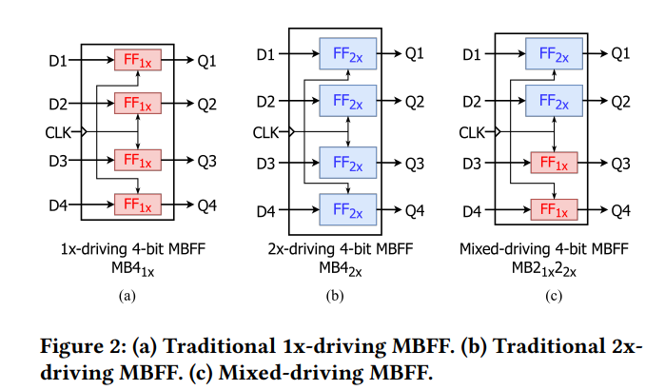
Introduction

Slide 7
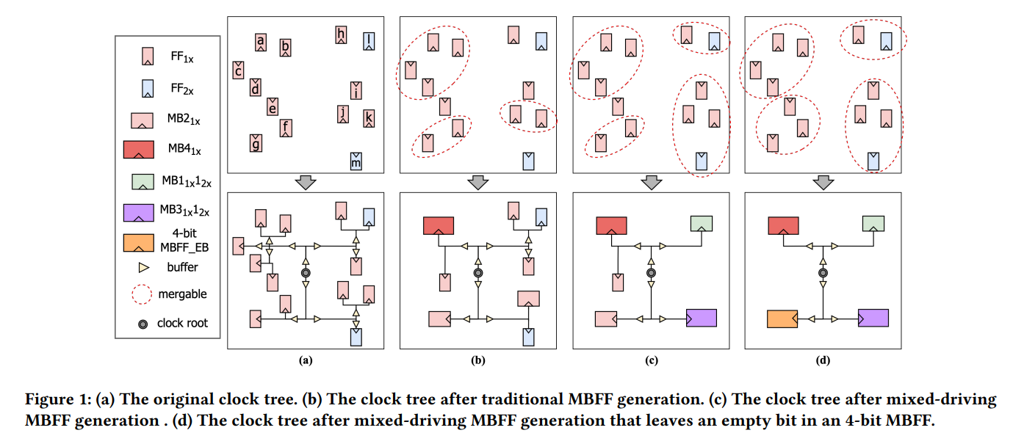
Introduction

Slide 8
Outline
Introduction
Problem Formulation
Proposed Approach
Compute Feasible Regions of FFs
Find All Maximal Cliques in Multiple Rectangle Intersection Graphs
Non-Conflicting MBFFs Generation
Location Assignment
Timing-Driven MBFF Sizing
Experimental Result

Slide 9
Problem Formulation
An MBFF library containing uniform-driving and mixed-driving MBFFs, where the driving strength is from 1x to 𝑛x and the amount of bits is from 2 to 𝑘, is adopted
The Mixed-Driving MBFF Generation Problem is defined as follows:
Input
A netlist
An associated legal placement
If there are uniform-driving MBFFs in the design, they will be pre-processed by decomposing them into multiple single-bit FFs while keeping the driving strengths intact
Output
A refined netlist containing mixed-driving MBFFs
A refined placement without timing violations
The objective is to minimize the amount of oversized MBFFs for power optimization, resulting in a low-power design

Slide 10
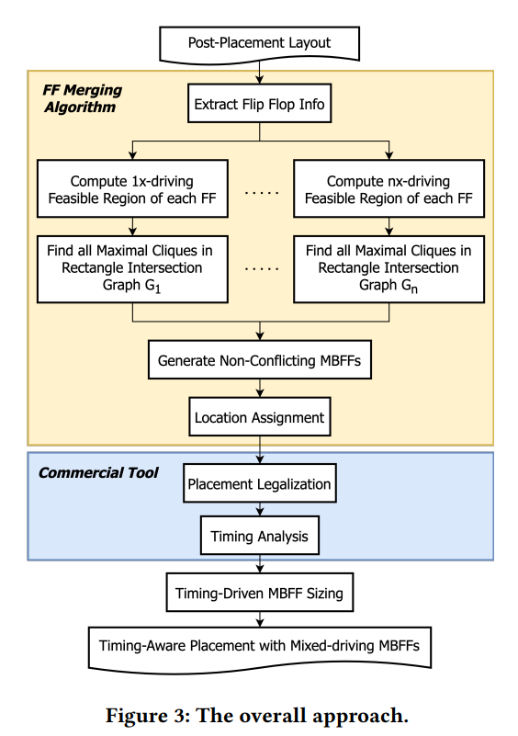
Problem Formulation

Slide 11
Outline
Introduction
Problem Formulation
Proposed Approach
Compute Feasible Regions of FFs
Find All Maximal Cliques in Multiple Rectangle Intersection Graphs
Non-Conflicting MBFFs Generation
Location Assignment
Timing-Driven MBFF Sizing
Experimental Result

Slide 12
Compute Feasible Regions of FFs
To obtain a mixed-driving MBFF design for maximum power reduction under timing constraints, the key idea is to allow upsizing of the original individual FFs to increase their merging choices when forming the MBFFs, then at the end downsizing some bits in the MBFFs formed after placement legalization while preserving timing

Slide 13
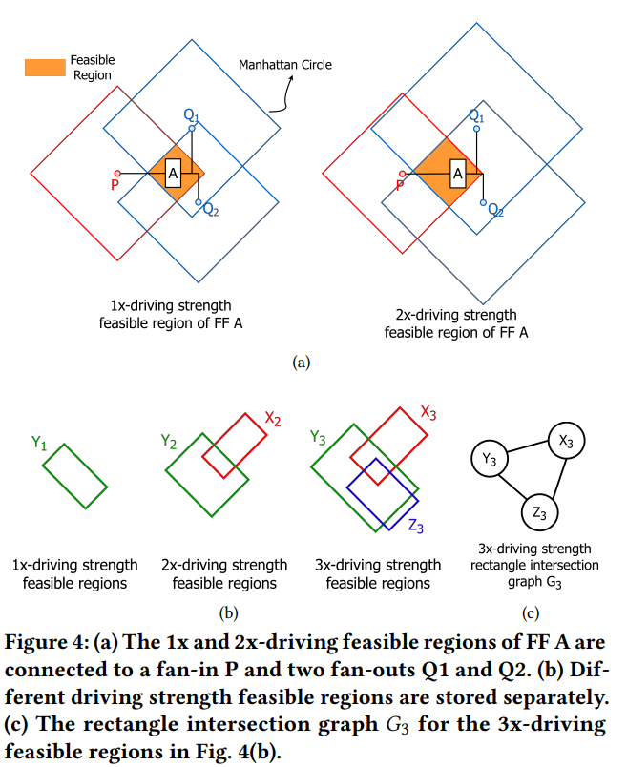
Compute Feasible Regions of FFs
Obtain the fan-in/fan-out pin locations and their timing slacks of original FF in the design under different driving strengths
Compute the timing feasible regions of each FF under different driving strengths
The maximal cliques in each rectangle intersection graph corresponding to maximal groups of FFs that can be merged without timing violations are found to facilitate the generation of potential MBFFs

Slide 14
Compute Feasible Regions of FFs
Obtain the fan-in/fan-out pin locations and their timing slacks of original FF in the design under different driving strengths
Compute the timing feasible regions of each FF under different driving strengths
The maximal cliques in each rectangle intersection graph corresponding to maximal groups of FFs that can be merged without timing violations are found to facilitate the generation of potential MBFFs

Slide 15
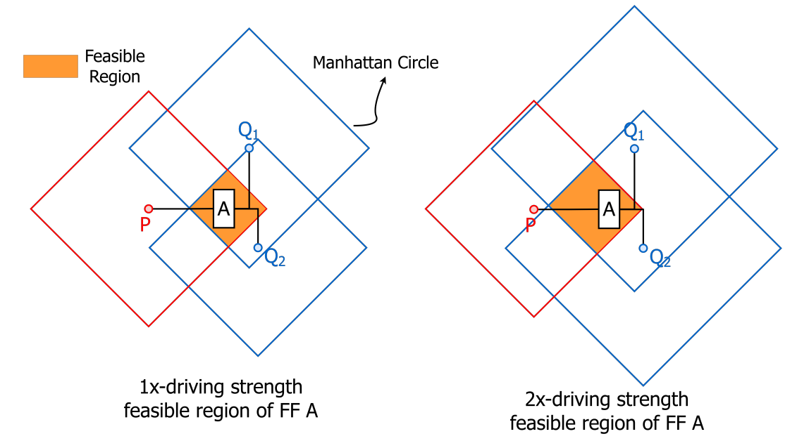
Relocate a FF without timing violation, multiple feasible regions for each FF are computed in this stage assuming that a FF can be upsized
A timing feasible region of a FF is the intersection area of several Manhattan circles, where each Manhattan circle is centered at the fan-in/fan-out pin of the FF with its radius determined by the timing slack between the corresponding fan-in/fan-out pin and the FF
The timing slack is converted to an estimated wirelength bound by table lookup
We compute multiple feasible regions for each single-bit FF assuming
different driving strengths that are at least as large as their originally
given driving strength
The reason we consider the option of sizing up a FF is that the feasible
region of a FF is usually larger when the FF is upsized
Notes:
Single bit FF A is a 2x-driving FF

Slide 16
Compute Feasible Regions of FFs
Obtain the fan-in/fan-out pin locations and their timing slacks of original FF in the design under different driving strengths
Compute the timing feasible regions of each FF under different driving strengths
The maximal cliques in each rectangle intersection graph corresponding to maximal groups of FFs that can be merged without timing violations are found to facilitate the generation of potential MBFFs

Slide 17
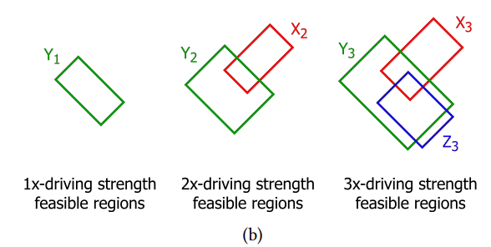
Suppose the cell library provides 1x, 2x, and 3x-driving FFs
suppose in the original netlist, FFs 𝑋, 𝑌 ,and 𝑍 are 2x-driving, 1x-driving, and 3x-driving, respectively.
So for X, we will find the 2x and 3x driven strength
So for Y, we will find the 1x, 2x and 3x driven strength
So for Z, we will find the 3x driven strength
Notes:
Single bit FF A is a 2x-driving FF

Slide 18
Compute Feasible Regions of FFs
Obtain the fan-in/fan-out pin locations and their timing slacks of original FF in the design under different driving strengths
Compute the timing feasible regions of each FF under different driving strengths
The maximal cliques in each rectangle intersection graph corresponding to maximal groups of FFs that can be merged without timing violations are found to facilitate the generation of potential MBFFs

Slide 19
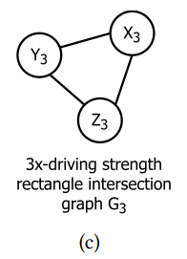
The intersections of the 𝑖x-driving feasible regions of the original FFs can be described by a rectangle intersection graph 𝐺𝑖
Each vertex corresponds to a 𝑖x-driving feasible region of an original FF
There is an edge between two vertices if their corresponding 𝑖x-driving feasible regions intersect
An intersection of the 𝑖x-driving feasible regions of multiple original FFs corresponds to a clique in the rectangle intersection graph 𝐺𝑖
Any set of original FFs that can form an 𝑖x-driving MBFF
without timing constraint violation must belong to some
maximal cliques in 𝐺𝑖
So we have to find all maximal cliques of sizes ≥ 2 in
each rectangle intersection graph
Notes:
Single bit FF A is a 2x-driving FF

Slide 20
Outline
Introduction
Problem Formulation
Proposed Approach
Compute Feasible Regions of FFs
Find All Maximal Cliques in Multiple Rectangle Intersection Graphs
Non-Conflicting MBFFs Generation
Location Assignment
Timing-Driven MBFF Sizing
Experimental Result

Slide 21
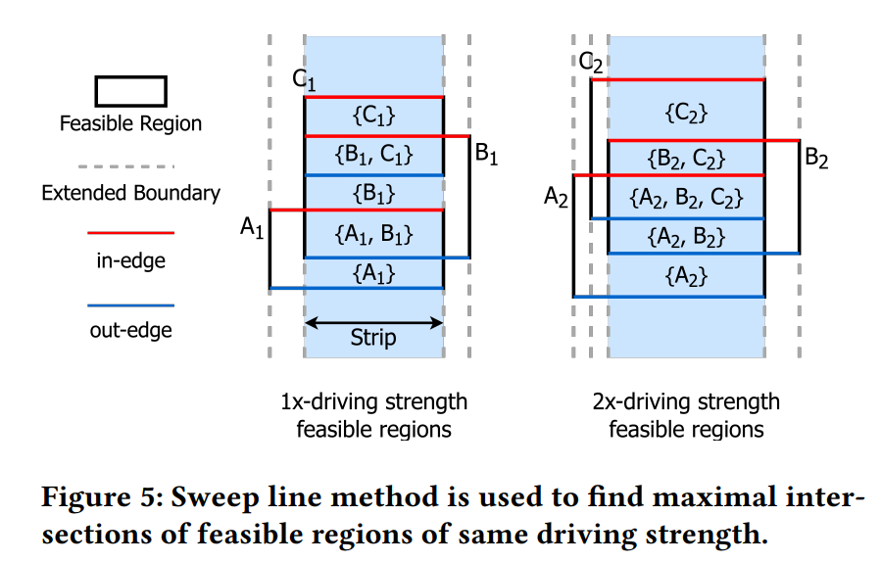
Find All Maximal Cliques in Multiple Rectangle Intersection Graphs

Slide 22
Find All Maximal Cliques in Multiple Rectangle Intersection Graphs
Use sweep line method :
Rotate the entire chip by 45° to make it vertical
Then the plane is divided into a number of vertical strips by extending all vertical boundaries of the 𝑖x-driving feasible regions
We scan each strip from top to bottom to identify the top boundaries of the rectangle scalled in-edges and the bottom boundaries of the rectangles called out-edges
A clique (i.e., an intersection of multiple rectangles) is maximal within a strip if its size is greater than the clique directly above it and the clique directly below it in the same strip

Slide 23
Thank You for Listening!

